Slide 1

riselab - Clipper

Slide 2

What is Clipper?
Clipper is a low-latency prediction serving system for machine learning.
Clipper serves predictions for large-scale, interactive applications.
Clipper makes it simple to integrate machine learning into user-facing serving systems.

Slide 3
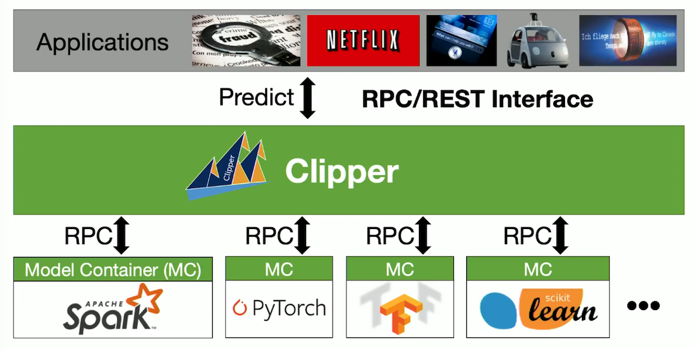
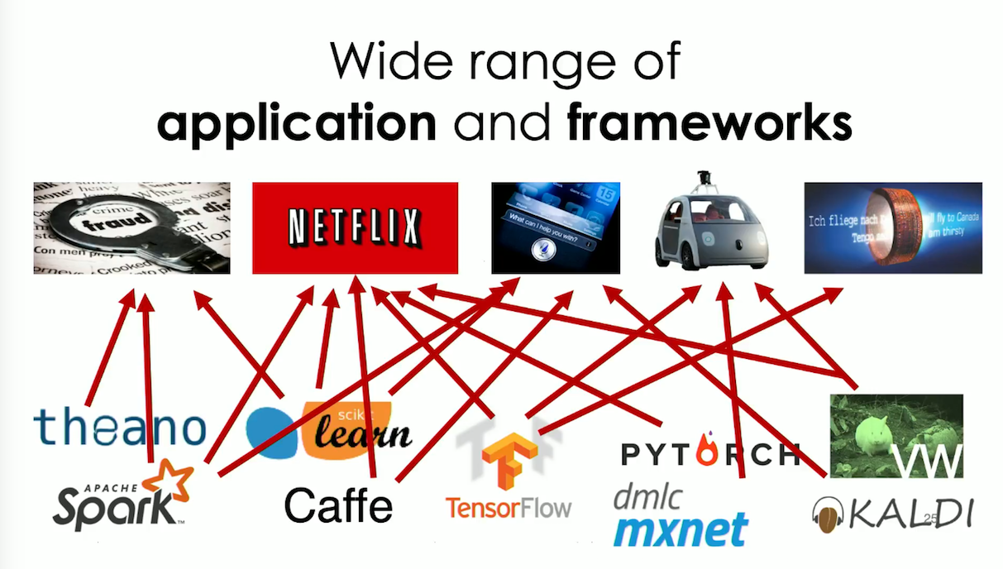
Why use Clipper?
Fast and scalable;
Manageable;
Affordable.

Slide 4
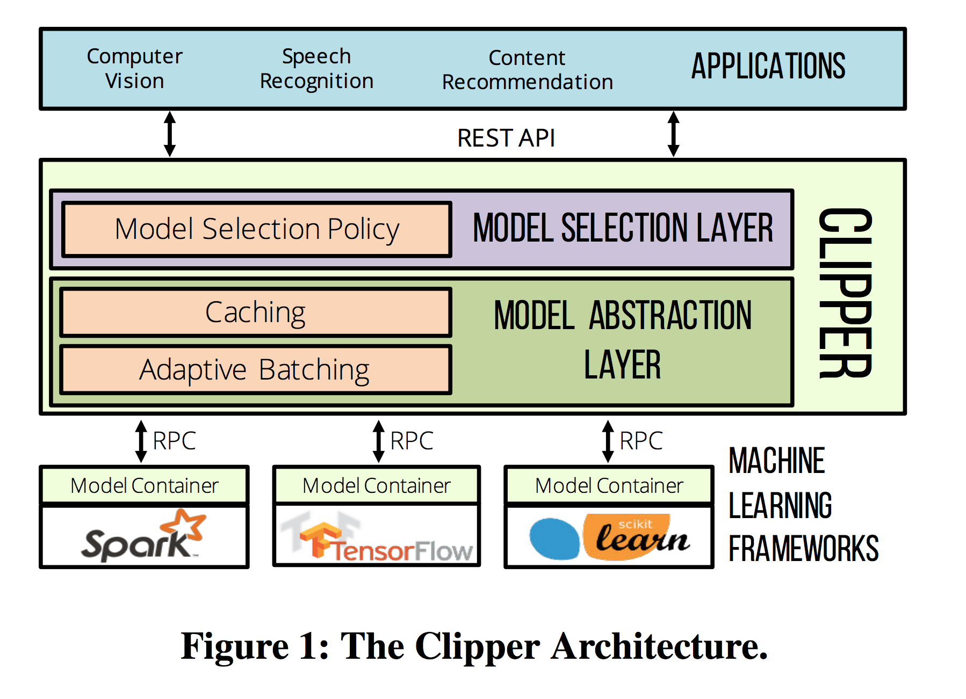
Clipper’s Architecture:
It can recognize queries written by Python, C, C++ and R.
It currently supports Scikit-Learn, PySpark, TensorFlow, PyTorch, MXNet, XGBoost.
Also supports arbitrary R functions.

Slide 5
Other Features:
Clipper provides a library of model deployers.
Deployer automatically and intelligently saves all prediction code.
Replicates training environment and loads prediction code in a Clipper model container.
Clipper makes it easier for data scientists to deploy models directly before the training processes without knowing anything about Docker.

Slide 6
After this brief introduction of Clipper, let’s do a quick demo to show how it works.

